Slide 1
CS 211: Computer Architecture Digital Logic
Abhishek Bhattacharjee
Topics:
Transistors
Logic Gates
Combinational Circuits
Karnaugh Maps
Reading:
Chapter 4: Section 4.2

Slide 2
Transistor: Building Block of Computers
Microprocessors contain millions (billions) of transistors
Intel Pentium 4 (2000): 48 million
IBM PowerPC 750FX (2002): 38 million
IBM/Apple PowerPC G5 (2003): 58 million
Logically, each transistor acts as a switch
Combined to implement logic functions
AND, OR, NOT
Combined to build higher-level structures
Adder, multiplexer, decoder, register, …
Combined to build processor
Notes:
Intel and Pentium are trademarks of Intel Corporation. IBM and PowerPC are trademarks of International Business Machines Corporation. Apple is a trademark of Apple Computer, Inc.

Slide 3
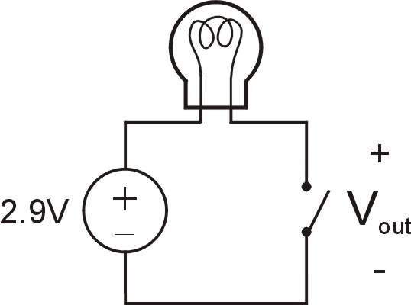
Simple Switch Circuit
Switch open:
No current through circuit
Light is off
V_{out} is +2.9V
Switch closed:
Current flows
Light is on
V_{out} is 0V
Switch-based circuits can easily represent two states:
on/off, open/closed, voltage/no voltage.

Slide 4

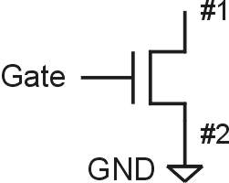
n-type MOS Transistor
MOS = Metal Oxide Semiconductor
two types: n-type and p-type
n-type
when Gate has positive voltage, short circuit between #1 and #2
when Gate has zero voltage, open circuit between #1 and #2
Gate = 1
Gate = 0

Slide 5
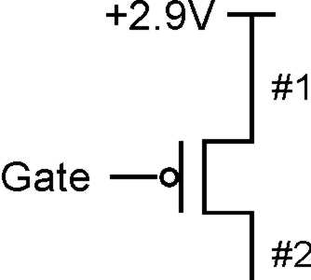
p-type MOS Transistor
p-type is complementary to n-type
when Gate has positive voltage, open circuit between #1 and #2
when Gate has zero voltage, short circuit between #1 and #2
Gate = 1
Gate = 0

Slide 6
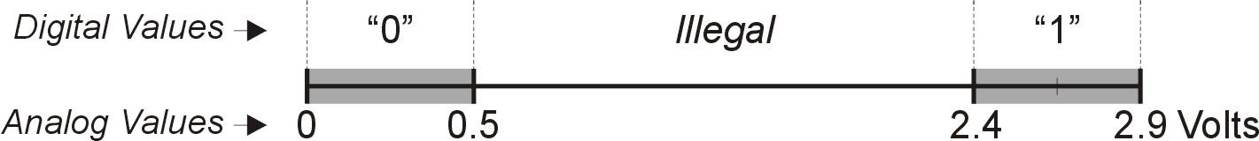
Logic Gates
Use transistors to implement logical functions: AND, OR, NOT
Digital symbols:
recall that we assign a range of analog voltages to each digital (logic) symbol
assignment of voltage ranges depends on electrical properties of transistors being used
typical values for "1": +5V, +3.3V, +2.9V
from now on we'll use +2.9V

Slide 7
CMOS Circuit
Complementary MOS
Uses both n-type and p-type MOS transistors
p-type
Attached to + voltage
Pulls output voltage UP when input is zero
n-type
Attached to GND
Pulls output voltage DOWN when input is one
MOS transistors are combined to form Logic Gates
For all inputs, make sure that output is either connected to GND or to +, but not both!

Slide 8
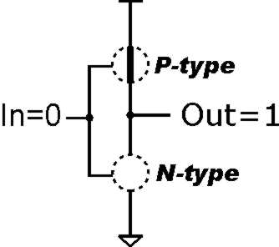
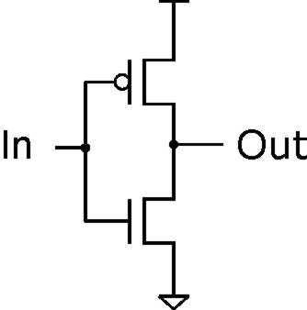
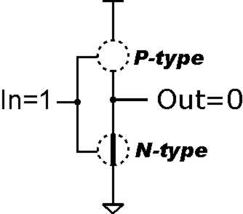
Inverter (NOT Gate)
Truth table
In | Out
0 V | 2.9 V
2.9 V | 0 V
In | Out
0 | 1
1 | 0

Slide 9
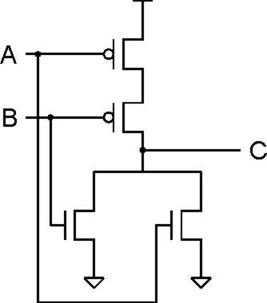
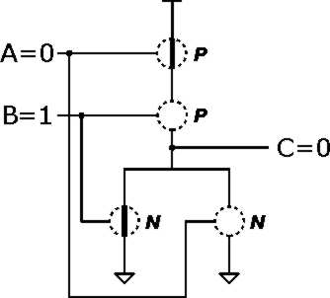
NOR Gate
A | B | C
0 | 0 | 1
0 | 1 | 0
1 | 0 | 0
1 | 1 | 0
Note: Serial structure on top, parallel on bottom.

Slide 10
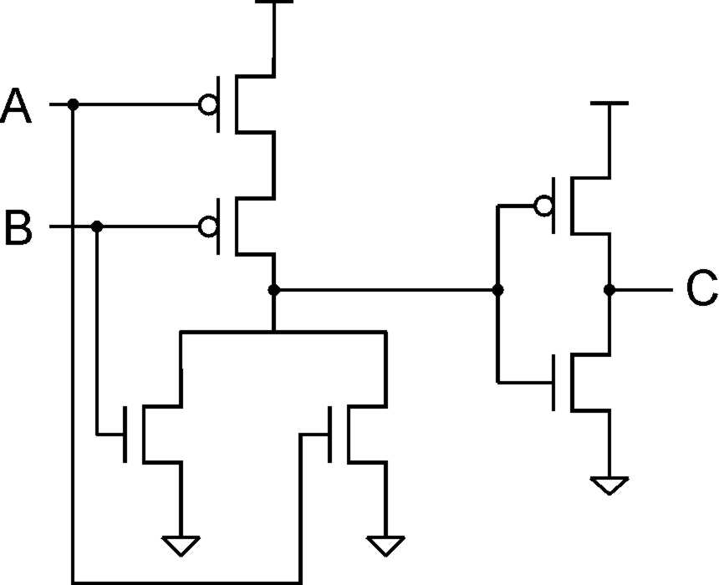
OR Gate
A | B | C
0 | 0 | 0
0 | 1 | 1
1 | 0 | 1
1 | 1 | 1
Add inverter to NOR.

Slide 11
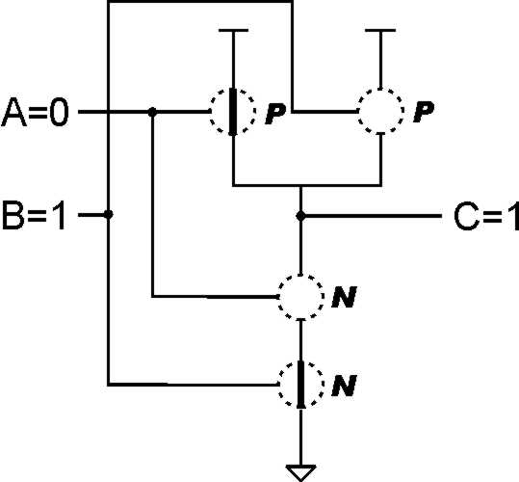
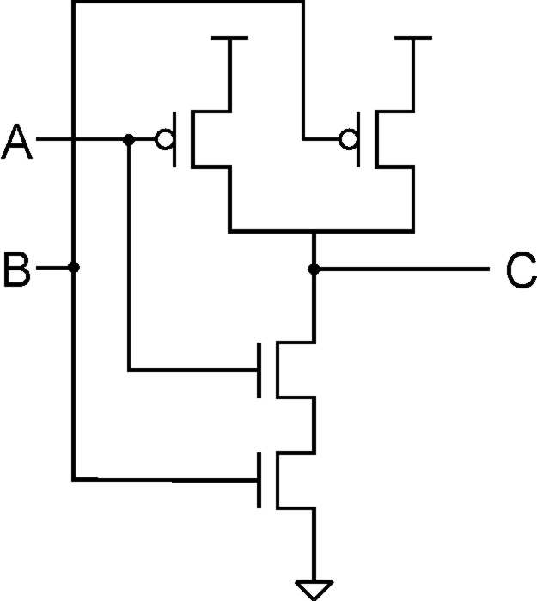
NAND Gate (AND-NOT)
A | B | C
0 | 0 | 1
0 | 1 | 1
1 | 0 | 1
1 | 1 | 0
Note: Parallel structure on top, serial on bottom.

Slide 12
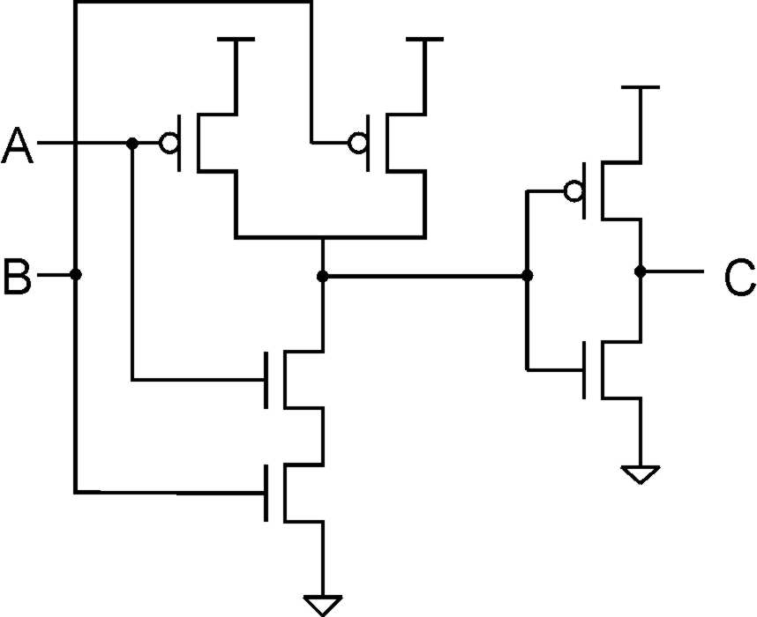
AND Gate
A | B | C
0 | 0 | 0
0 | 1 | 0
1 | 0 | 0
1 | 1 | 1
Add inverter to NAND.

Slide 13
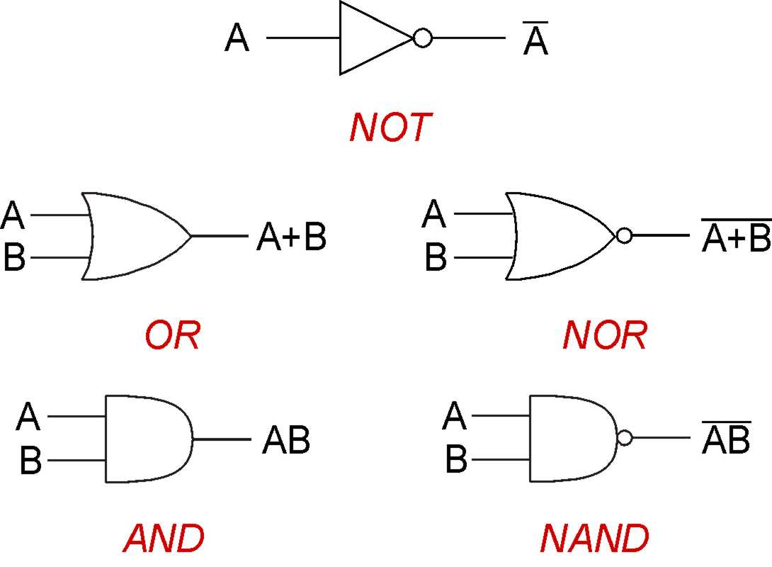
Basic Logic Gates Symbols

Slide 14
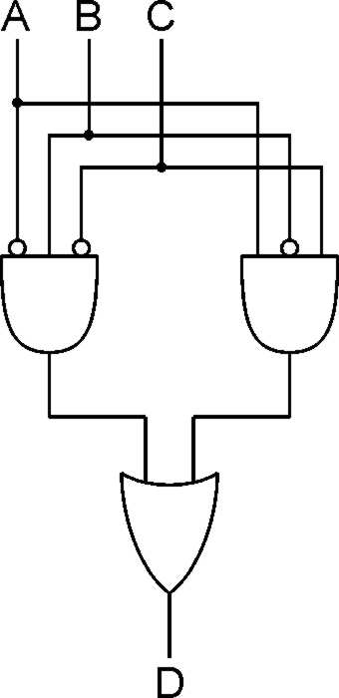
Logical Completeness
Can implement ANY truth table with AND, OR, NOT.
A | B | C | D
0 | 0 | 0 | 0
0 | 0 | 1 | 0
0 | 1 | 0 | 1
0 | 1 | 1 | 0
1 | 0 | 0 | 0
1 | 0 | 1 | 1
1 | 1 | 0 | 0
1 | 1 | 1 | 0
1. AND combinations that yield a "1" in the truth table.
2. OR the results of the AND gates.
Notes:
Note the use of the bubbles (NOT) in the input.

Slide 15
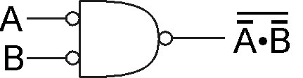
DeMorgan's Law
Converting AND to OR (with some help from NOT)
Consider the following gate:
To convert AND to OR
(or vice versa),
invert inputs and output.
A | B
0 | 0 | 1 | 1 | 1 | 0
0 | 1 | 1 | 0 | 0 | 1
1 | 0 | 0 | 1 | 0 | 1
1 | 1 | 0 | 0 | 0 | 1
Generally, DeMorgan’s Laws:
PQ = P + Q
P + Q = P Q
Same as A+B!
Notes:
If there's time, perhaps discuss how all gates can be implemented with NAND (or NOR).
Therefore, you can implement any truth table using only NAND (or NOR) gates.

Slide 16
NAND and NOR Functional Completeness
Any gate can be implemented using either NOR or NAND gates.
Why is this important?
When building a chip, easier to build one with all of the same gates.

Slide 17
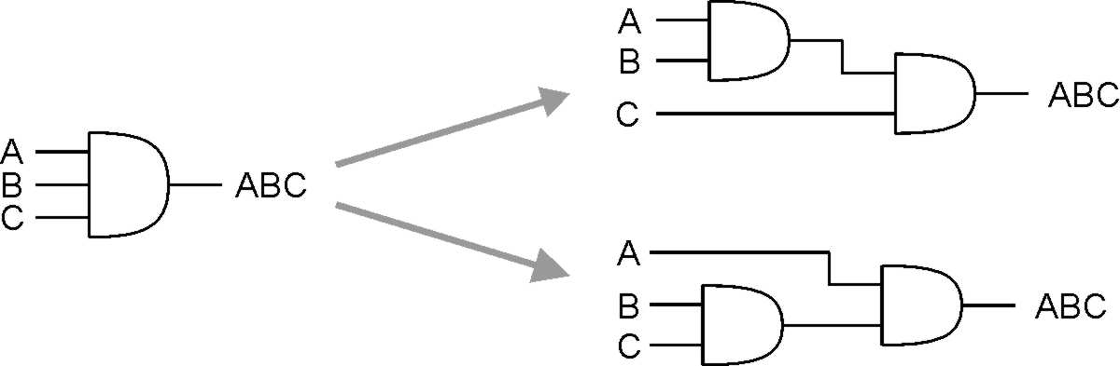
More than 2 Inputs?
AND/OR can take any number of inputs.
AND = 1 if all inputs are 1.
OR = 1 if any input is 1.
Similar for NAND/NOR.
Can implement with multiple two-input gates or with single CMOS circuit.
Notes:
NAND and NOR are not associative.
Jim Conrad’s example:
NAND(NAND(0,0), 1) = NAND(1, 1) = 0
NAND(0, NAND(0,1)) = NAND(0, 0) = 1

Slide 18
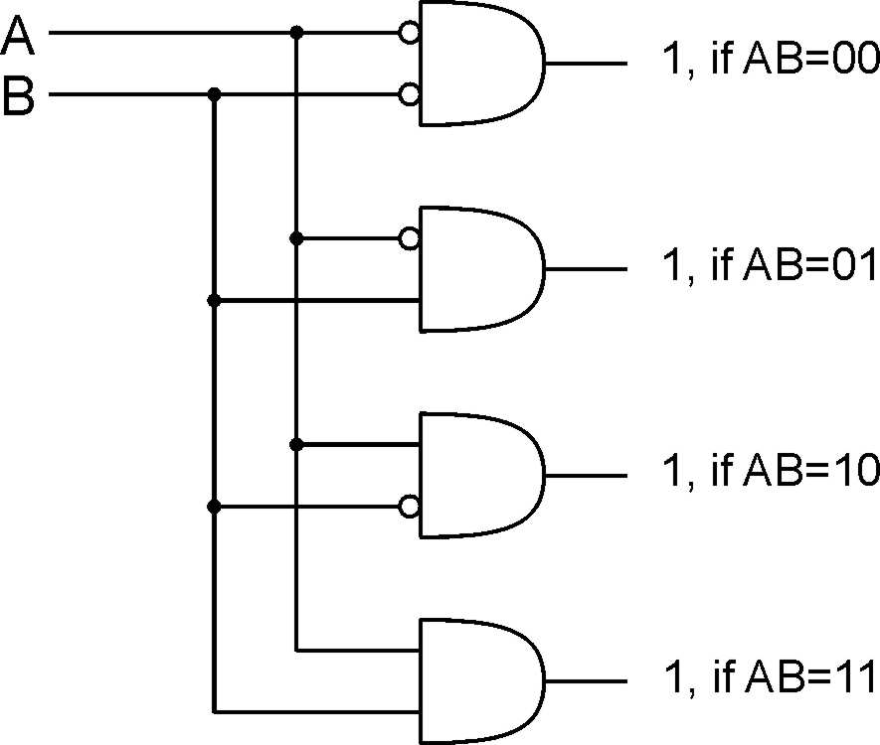
Decoder
n inputs, 2^{n} outputs
exactly one output is 1 for each possible input pattern
2-bit
decoder
Notes:
Uses of decoder:
convert memory/register address to a control line that selects that location
convert an opcode to one of n control lines

Slide 19
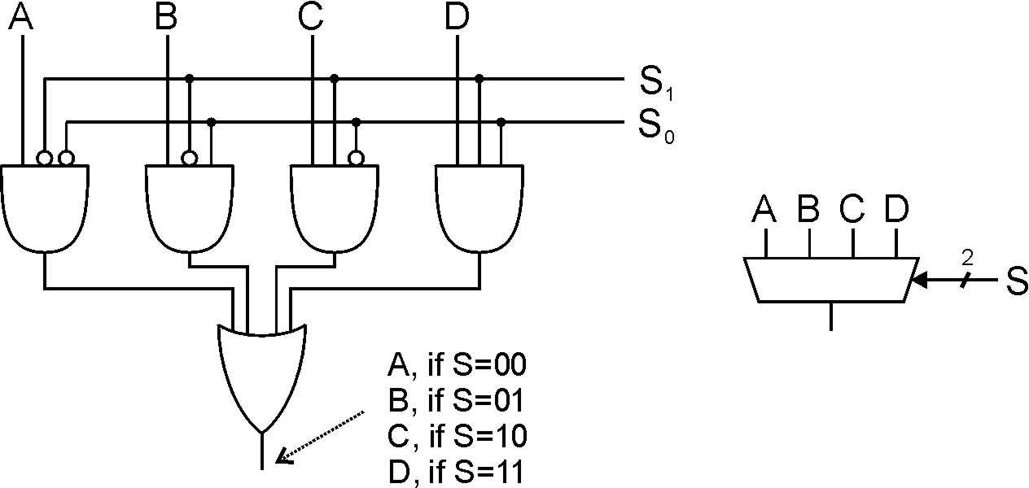
Multiplexer (MUX)
n-bit selector and 2^{n} inputs, one output
output equals one of the inputs, depending on selector
4-to-1 MUX
Notes:
Another view: decode S, and AND each output with one of the MUX inputs.
Also explain multi-bit inputs.
Uses of multiplexer:
select which input to use for function
select which computed value to pass to next stage (or to place on bus)

Slide 20
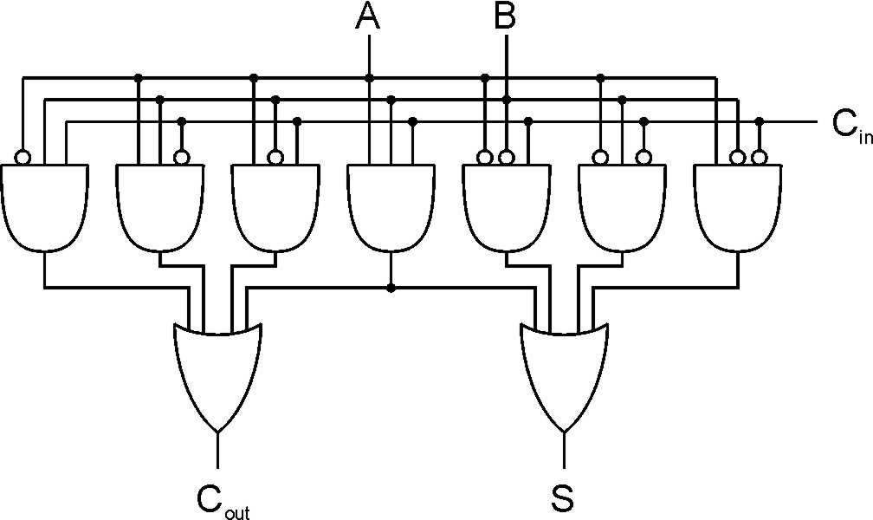
Full Adder
Add two bits and carry-in, produce one-bit sum and carry-out.
A | B | C_{in} | S | C_{out}
0 | 0 | 0 | 0 | 0
0 | 0 | 1 | 1 | 0
0 | 1 | 0 | 1 | 0
0 | 1 | 1 | 0 | 1
1 | 0 | 0 | 1 | 0
1 | 0 | 1 | 0 | 1
1 | 1 | 0 | 0 | 1
1 | 1 | 1 | 1 | 1
Notes:
A half-adder is one that doesn't take a carry-in.
Sum is one when 1 or 3 inputs are one. Carry-out is one when 2 or 3 inputs are one.

Slide 21
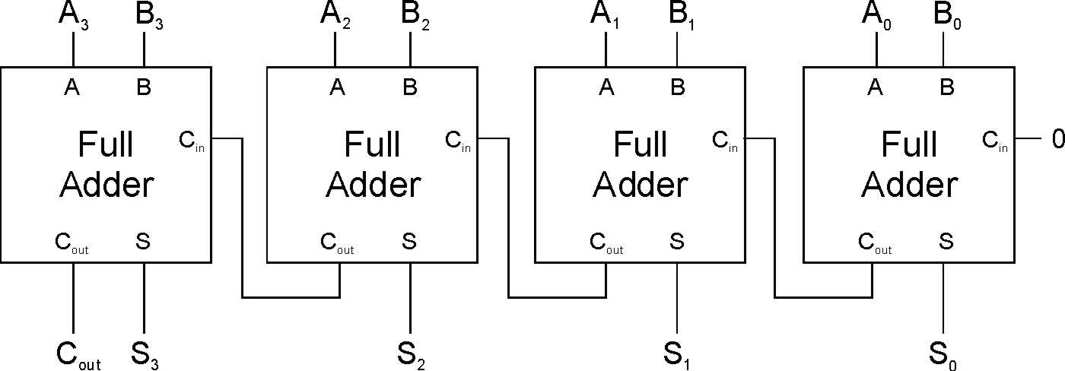
Four-bit Adder
Notes:
This is called a "ripple-carry" adder. The sum becomes valid as the carry ripples its way from the low bit to the high bit. How many gate delays until the output is settled?

Slide 22
Circuit Design
Have a good idea. What kind of circuit might be useful?
Derive a truth table for this circuit
Derive a Boolean expression for the truth table
Build a circuit given the Boolean expression
Building the circuit involves mapping the Boolean expression to actual gates. This part is easy.
Deriving the Boolean expression is easy. Deriving a good one is tricky.

Slide 23
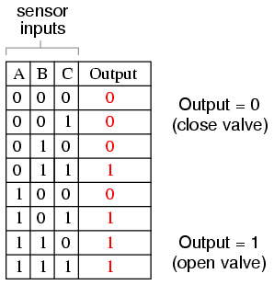
Converting Truth Table to Boolean Expression
Given a circuit, isolate the rows in which the output of the circuit should be true

Slide 24
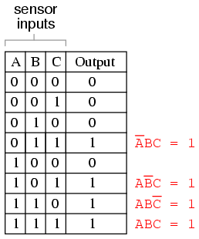
Converting Truth Table to Boolean Expression
Given a circuit, isolate that rows in which the output of the circuit should be true
A product term that contains exactly one instance of every variable is called a minterm

Slide 25
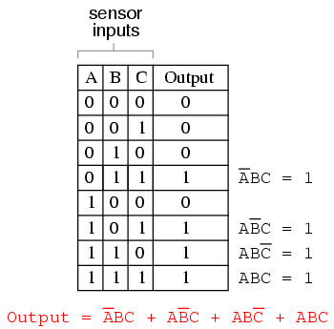
Converting Truth Table to Boolean Expression
Given the expressions for each row, build a larger Boolean expression for the entire table.
This is a sum-of-products (SOP) form.

Slide 26
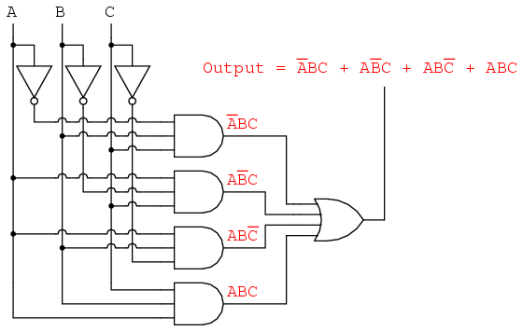
Converting Truth Table to Boolean Expression
Finally build the circuit.
Problem: SOP forms are often not minimal.
Solution: Make it minimal. We’ll go over two ways.

Slide 27
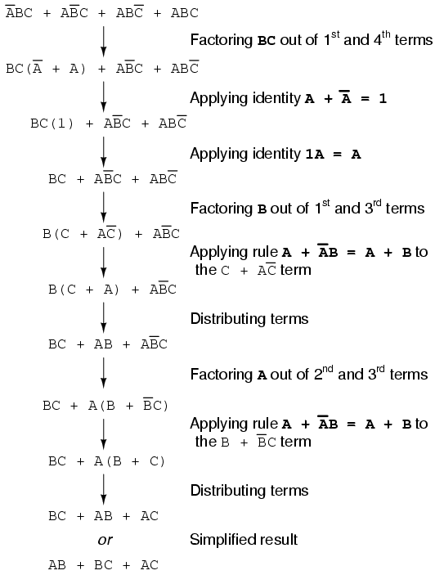
First Approach: Algebraic
Simply use the rules of Boolean logic

Slide 28
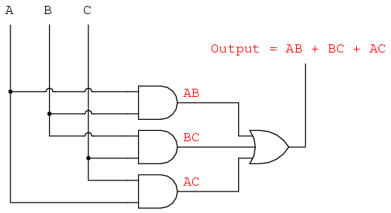
The Result

Slide 29
Karnaugh Maps or K-Maps
K-maps are a graphical technique to view minterms and how they relate.
The “map” is a diagram made up of squares, with each square representing a single minterm.
Minterms resulting in a “1” are marked as “1”, all others are marked “0”

Slide 30
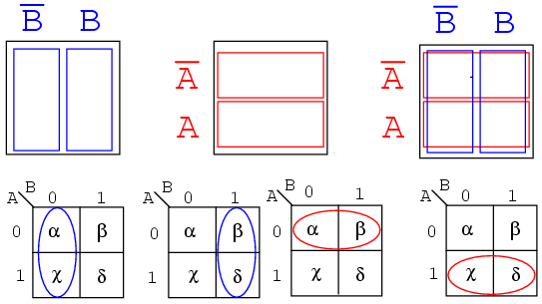
2 Variable K-Map

Slide 31
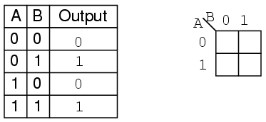
2 Variable K-Map

Slide 32
2 Variable K-Map
0
1
0
1

Slide 33
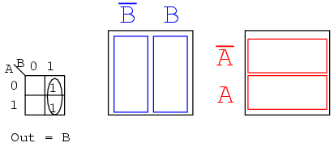
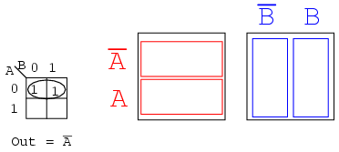
Finding Commonality

Slide 34
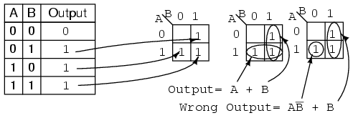
Finding the “best” solution
Grouping become simplified products.
Both are “correct”. “A+B” is preferred.

Slide 35
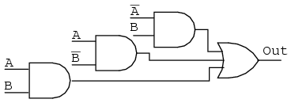
Simplify Example

Slide 36
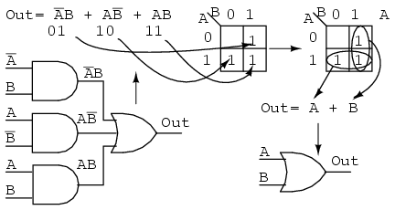
Simplify Example

Slide 37
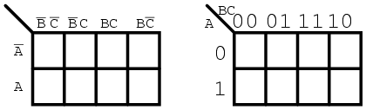
3 Variable K-Maps
C
B
Note in higher maps, several variables occupy a given axis
The sequence of 1s and 0s follow a Gray Code Sequence.

Slide 38
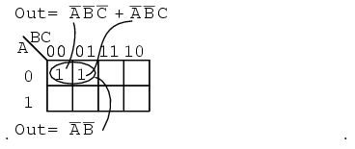
3 Variable K-Maps

Slide 39
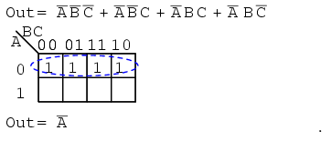
3 Variable K-Maps
C
B

Slide 40
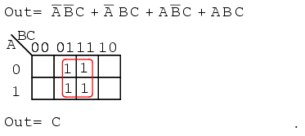
3 Variable K-Maps

Slide 41
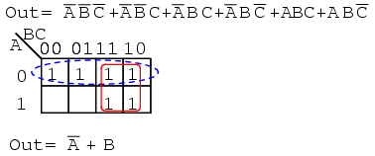
3 Variable K-Maps

Slide 42
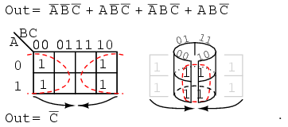
3 Variable K-Maps

Slide 43
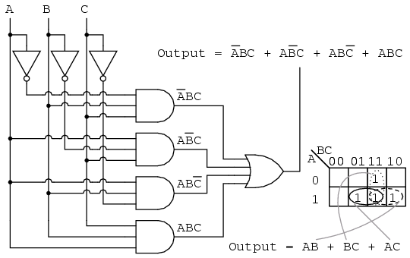
Back to our earlier example…..
The K-map and the algebraic produce the same result.

Slide 44
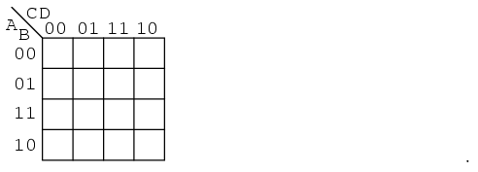
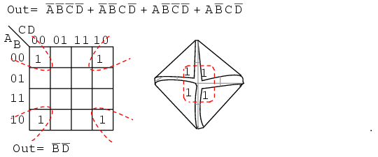
Up… up… and let’s keep going
D
B
A
C

Slide 45
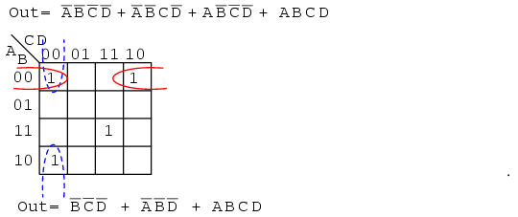
Few more examples
D
B
A
C

Slide 46
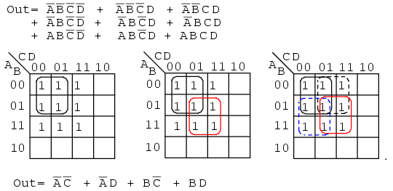
Few more examples
D
B
A
C

